Slide 1
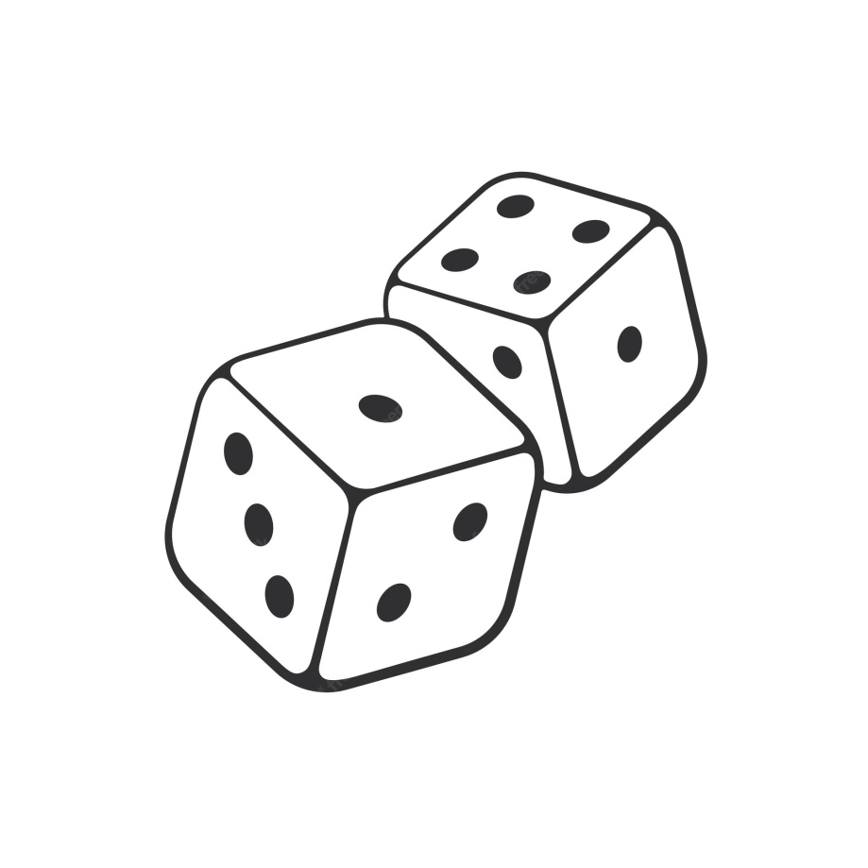
LP-5 Mini Project Multiplayer Chess
Rohit pendse 43356
Harshal Rajput 43361
Nisha Rudrwar 43364
Bhavana Sanap 43365
Satyajeet Sankpal 43366

Slide 2
Introduction
Distributed systems have transformed the way software applications are designed, developed, and deployed. One such application is multiplayer games, which enable players to compete against each other over a network. In this project , we present the development of a multiplayer chess game using the Swing user interface toolkit and Remote Method Invocation (RMI).
The game is designed to allow multiple players to play against each other, with the server managing the game state and the clients providing the user interface for players to interact with the game. It covers the architecture, design, and implementation of the game, including the use of the Model-View-Controller (MVC) design pattern. We also discuss the challenges faced during the development process and the solutions implemented to overcome them. The end product is a fully functional, interactive, and engaging chess game that can be played by multiple players over a network.
Chess is a two-person game in which each player controls 16 pieces across a checkerboard in an effort to checkmate the king of the other player. Chess is implemented in our project with a graphical user interface. The chess game adheres to the fundamental chess principles, and each chess piece can only move in accordance with movements that are legitimate for that piece.

Slide 3
Technologies used
This multiplayer Chess game uses DS concepts and developed using java programming. There is a game architecture, threaded server, java swing for GUI elements.

Slide 4
System Architecture
RMI stands for Remote Method Invocation. It is a mechanism that allows an object residing in one system (JVM) to access/invoke an object running on another JVM.
RMI is used to build distributed applications; it provides remote communication between Java
programs. It is provided in the package java.rmi.
In an RMI application, we write two programs, a server program (resides on the server) and
a client program (resides on the client).
Inside the server program, a remote object is created and reference of that
object is made available for the client (using the registry).
The client program requests the remote objects on the server and tries to invoke its methods.

Slide 5
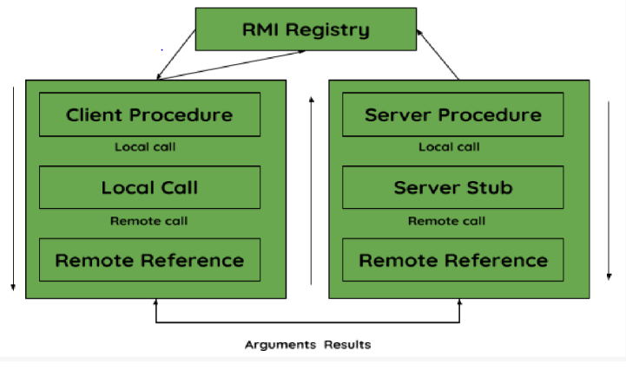

Slide 6
Conclusion
The threaded architecture allows for multiple players to interact with the game simultaneously. Each player will have their own thread, enabling them to make moves independently and providing a more interactive multiplayer experience.
With the use of threads, players can make moves concurrently, allowing for a more dynamic and responsive gameplay experience. Players can take their turns without waiting for other players to complete their moves. The threaded architecture provides a foundation for scalability. It allows for future enhancements such as adding more players, incorporating network multiplayer capabilities, or integrating AI opponents without significantly modifying the existing codebase.

Slide 7
Thank You!

